Slide 1
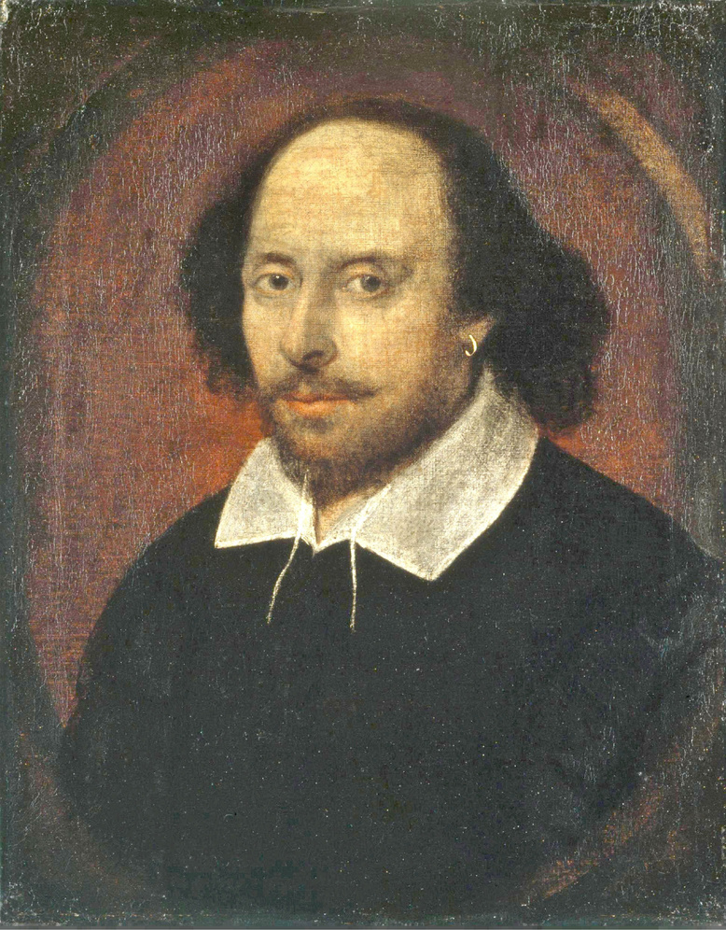
12/03/2021
SHAKESPEARIAN PLAYS
TEXT MINING
BEATRICE TOMASELLO
MSA
ISDS 4070

Slide 2
AGENDA
Part 1:
DATA
Part 2:
MANIPULATION
Part 3:
ANALYSIS

Slide 3
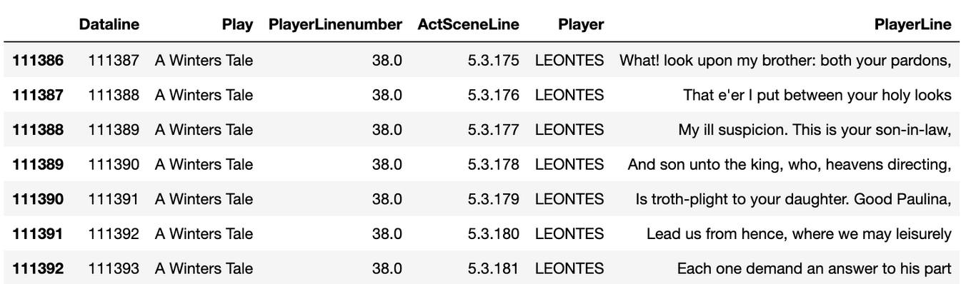
DATA
1.
CSV FILE
Containig lines from 36 Shakesperian plays.
- 11396 entries
- 6 columns
SOURCE
KAGGLE

Slide 4

MANIPULATION
2.
Listing
Removal of Punctuation and Stopwords
2.
3
Libraries
WordCloud
1.
4

Slide 5
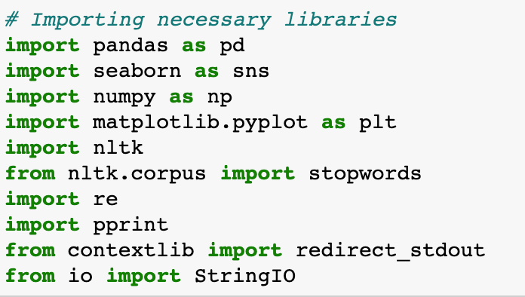
MANIPULATION
2.
Libraries
1.

Slide 6
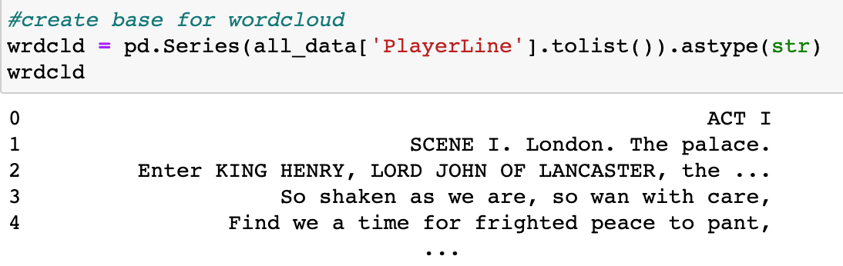
MANIPULATION
2.
Listing
2.

Slide 7
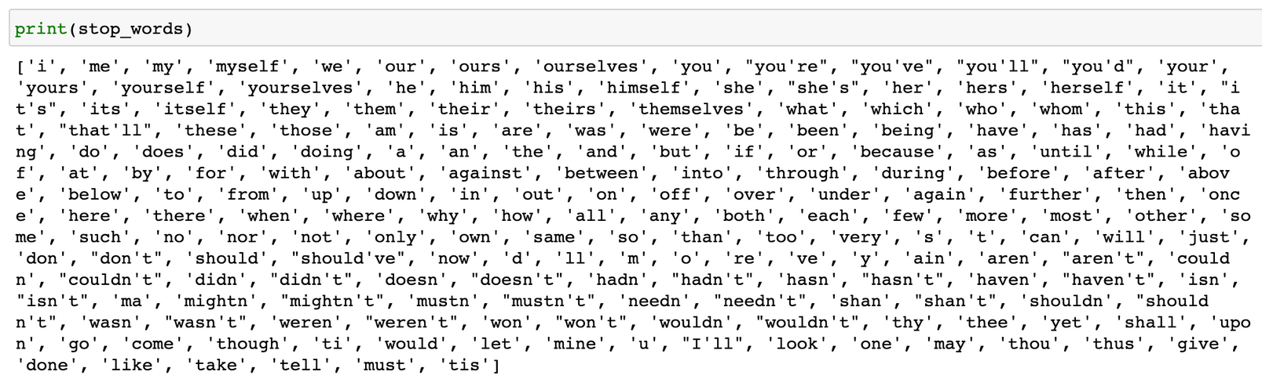
MANIPULATION
2.
ADDED
STOPWORDS
Removal of Punctuation and Stopwords
3

Slide 8

MANIPULATION
2.
WordCloud
4

Slide 9
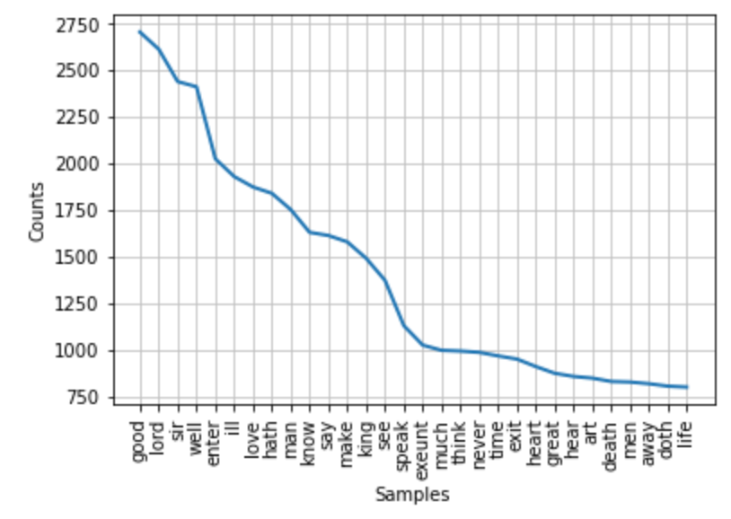
ANALYSIS
3.
Frequency Distribution of Words

Slide 10
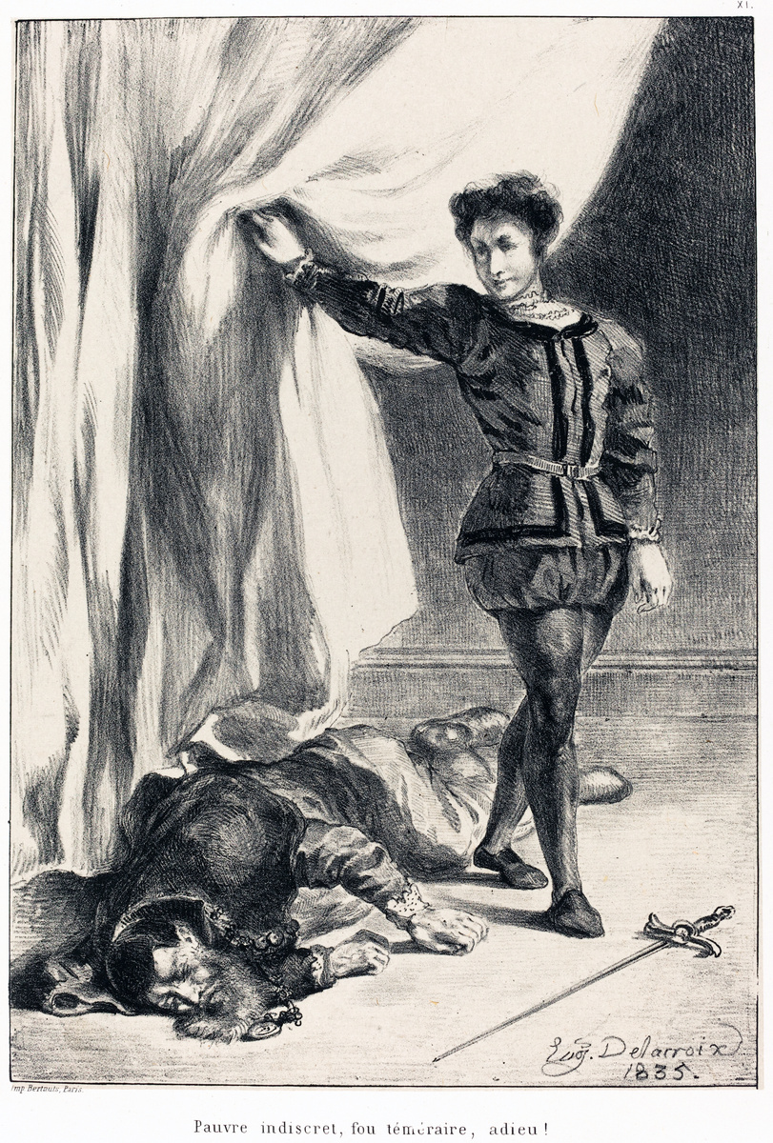
ANALYSIS
3.
Length of the Plays in Number of Lines
HAMLET
-
4244
CYMBELINE
-
3958
1.
3.
CORIOLANUS
-
3992
RICHARD III
-
3941
2.
4.

Slide 11
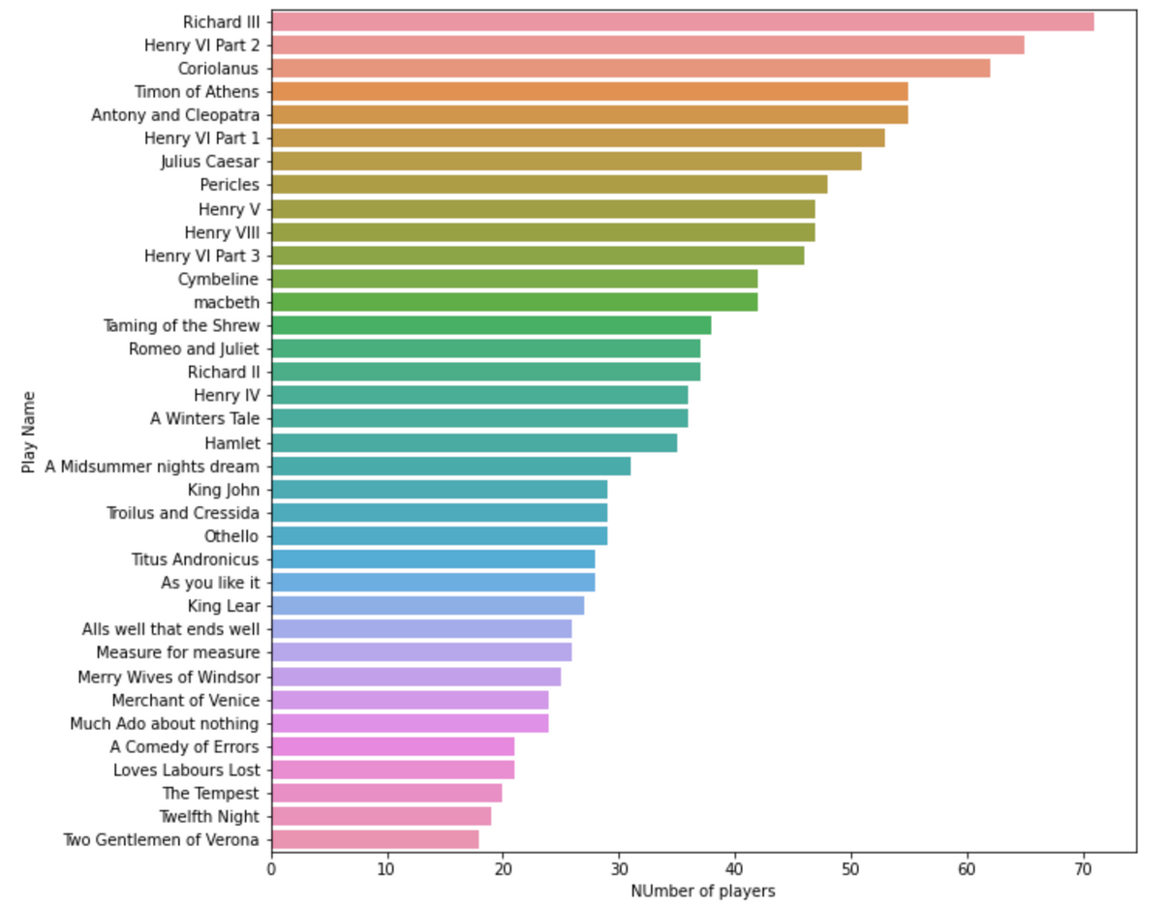
ANALYSIS
Number of Characters for each Play
3.

Slide 12
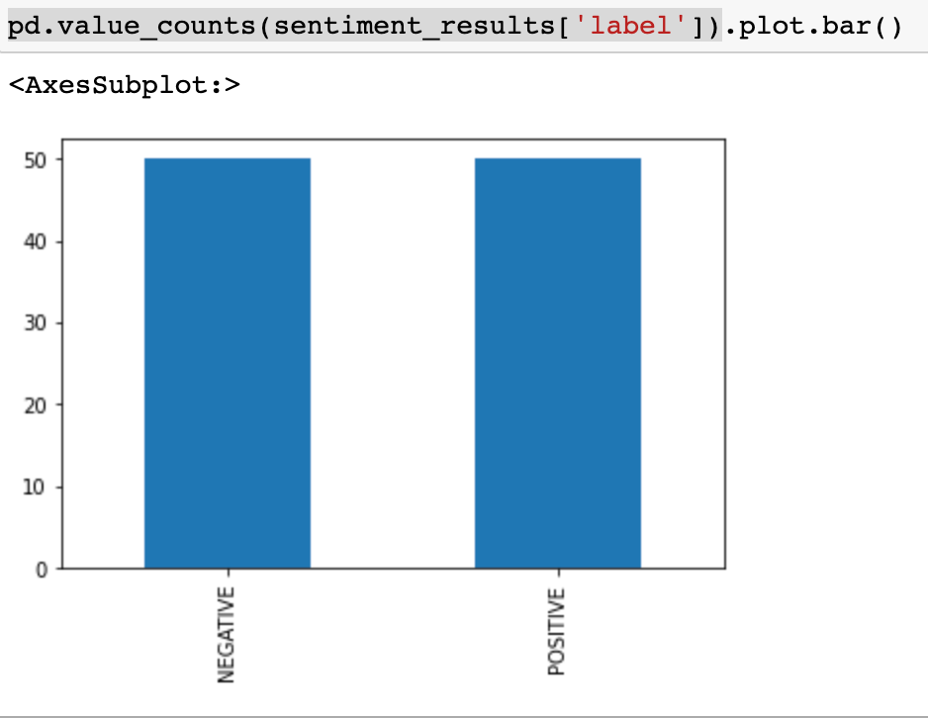
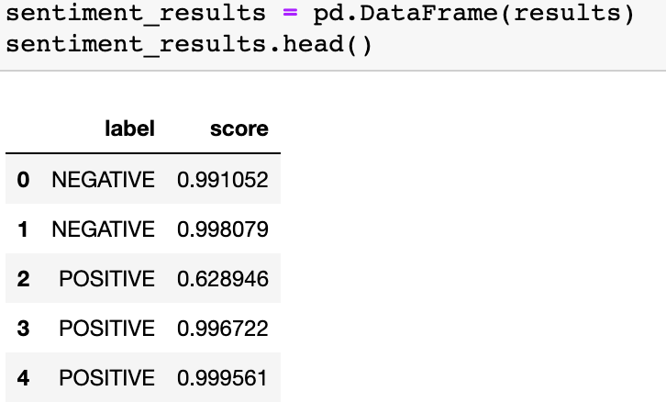
ANALYSIS
Sentiment Analysis
on a Sample of 100 Lines
3.

Slide 13
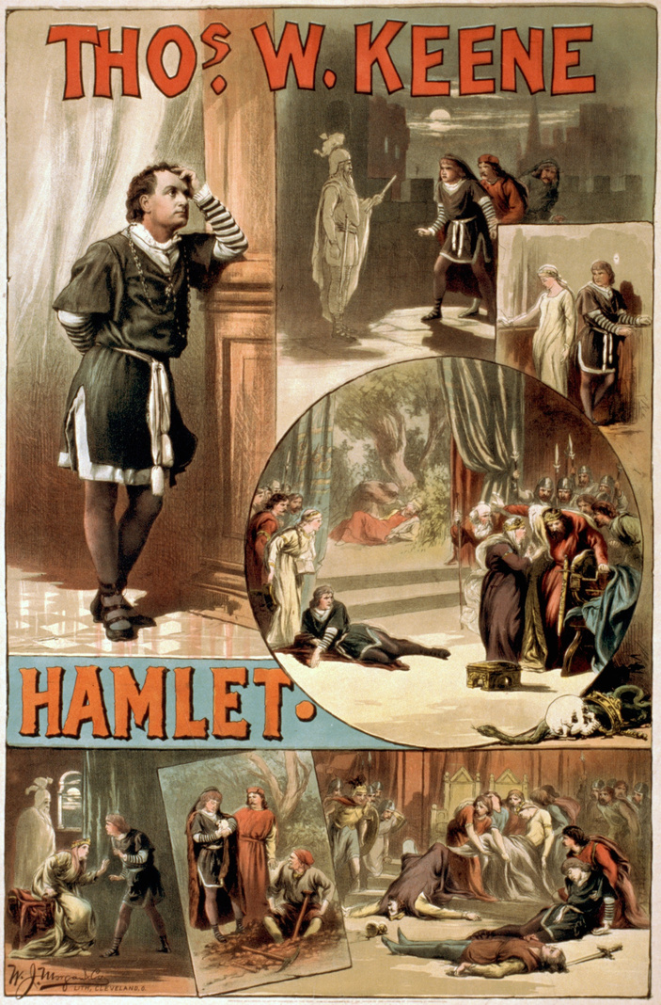
THANK YOU!
BEATRICE TOMASELLO

